Slide 1
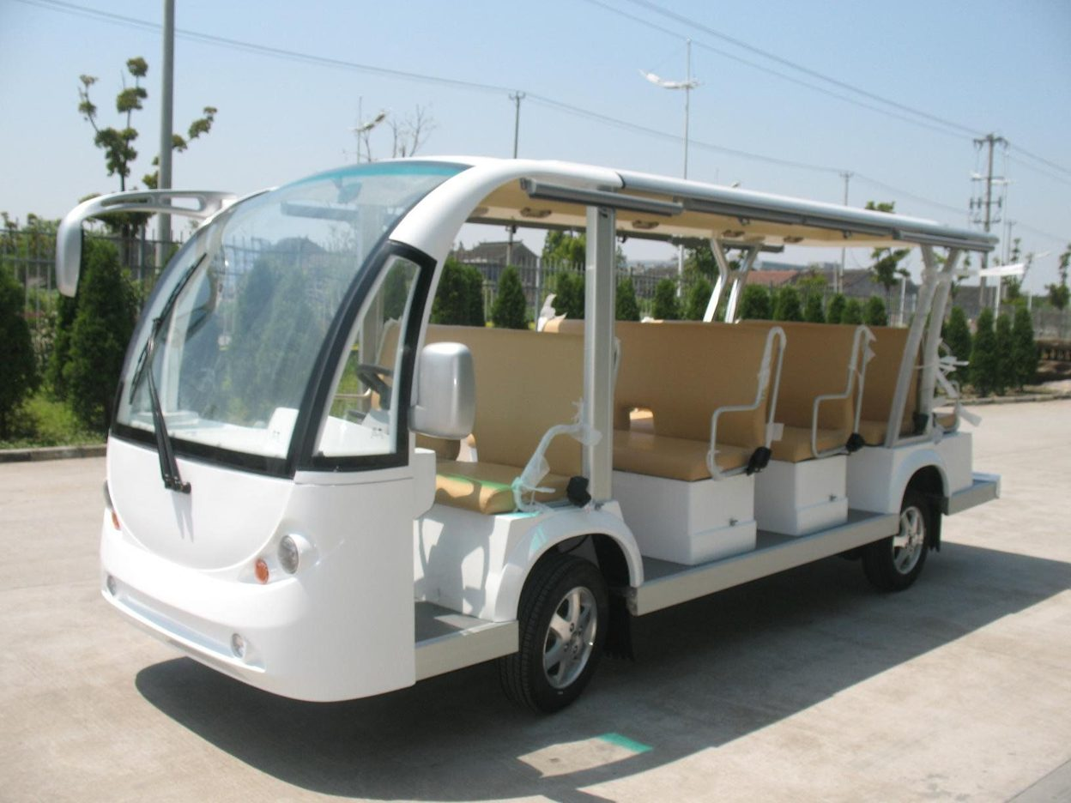
GPS Integration for NUST Shuttle Service

Slide 2



Meet the team
Abdur rehman​​
Syed muhammad abubakar​​
Asad ahmed
337668
337385
331881

Slide 3

Objectives
A tracking system for Nust Shuttle Service using ATMega32 microcontroller.

Slide 4
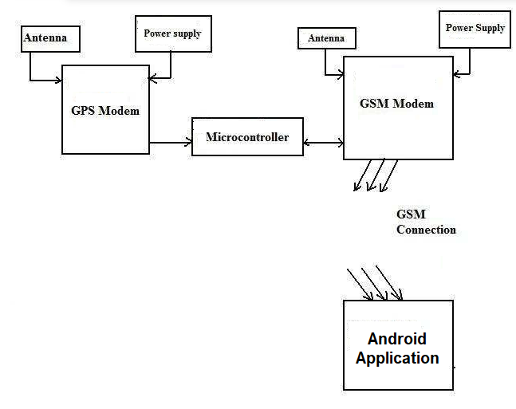
Block Diagram:

Slide 5

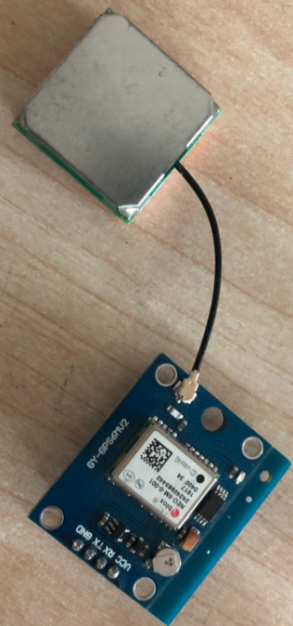
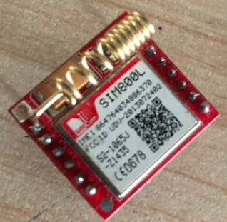
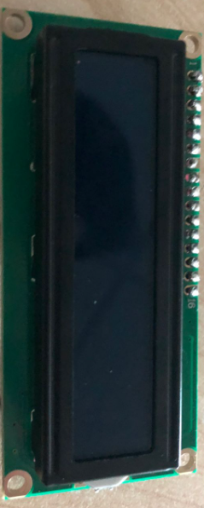
Components used:
NEO 6M
Sim 800l
Atmega32
For storing the GPS coordinates from Neo sim module and sending it to the GSM ​module.
GSM module for sending SMS messages to mobile application.
GPS module to provide the GPS coordinates.​
​
LCD
Android phone
16x2 liquid crystal display to show the GPS coordinates.

Slide 6
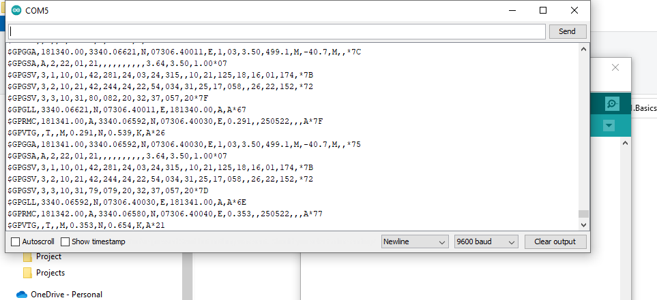
NMEA string:
The national marine electronics association (NMEA) is standard for GPS coordinates.
NEO 6M provides the coordinates in this format.
Filled with detailed information about the coordinates and time.
Contoso​
Competitors​
Our product is priced below that of other task management tools on the market​
Simple and easy to use app and website, compared to the complex tools of our competitors​
Affordability is the main draw for our consumers to our product​
Company A​ Product is more expensive​
Companies B & C ​ Product is expensive and inconvenient to use​
Companies D & E​ Product is affordable, but inconvenient to use

Slide 7
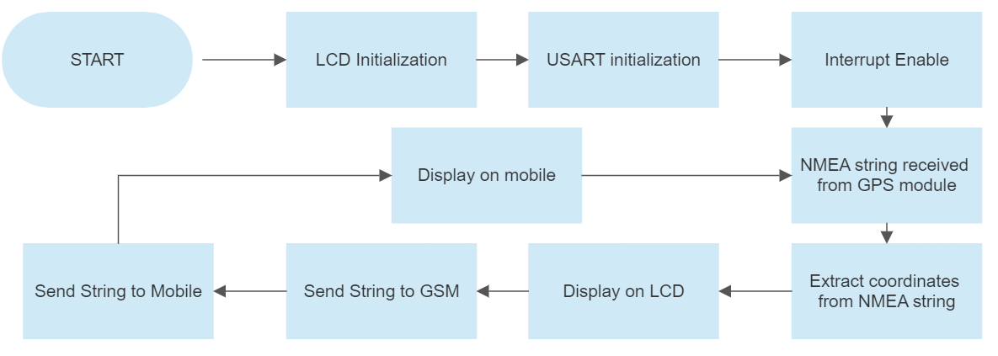
Flowchart

Slide 8
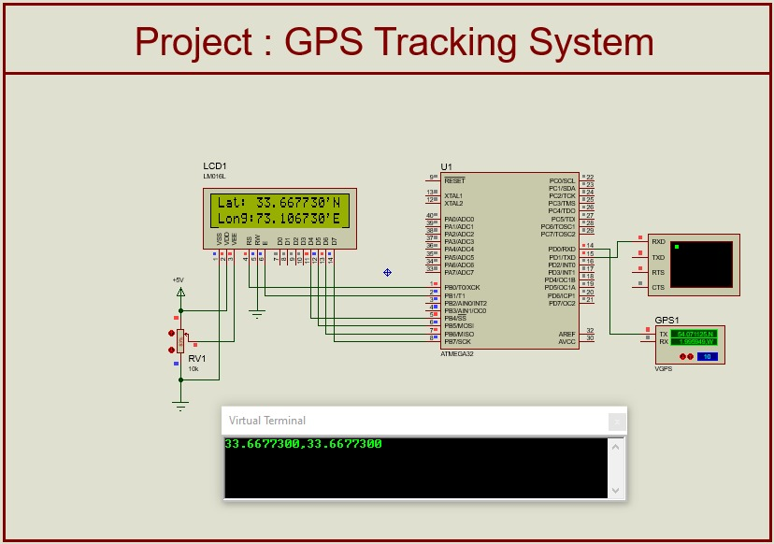
Simulation

Slide 9





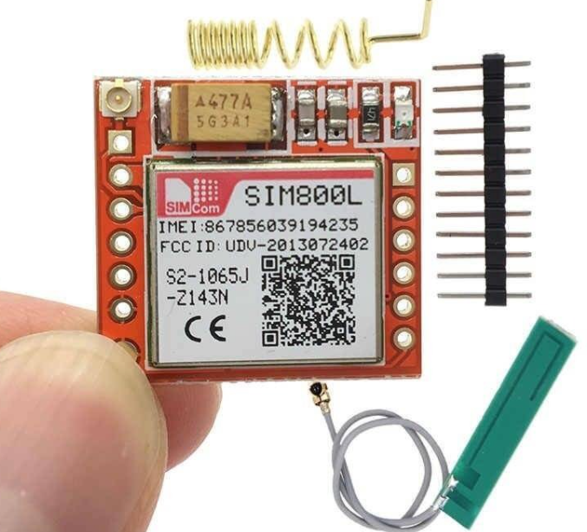
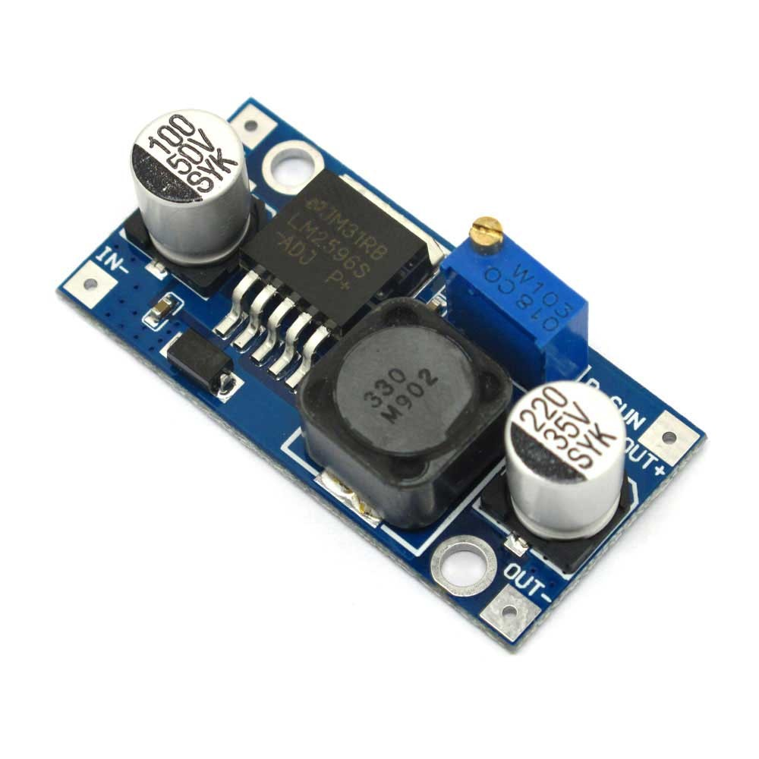
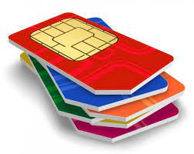
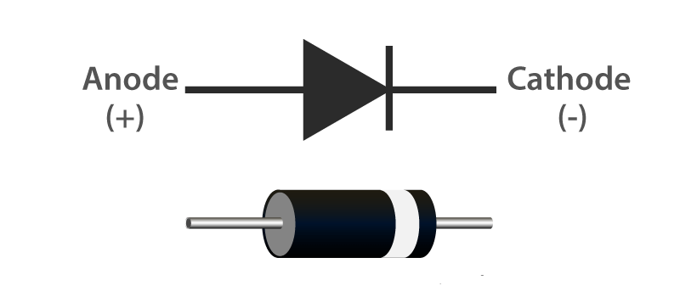
Problem with sim 800l:
Unable to connect to the network
Things we tried:
Different circuit configurations
Using sims of different networks
Changing locations
Changing antennas
Alternative: HC-05 Bluetooth Module.

Slide 10
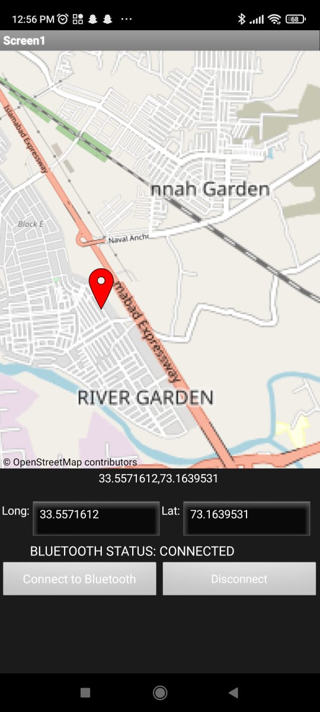
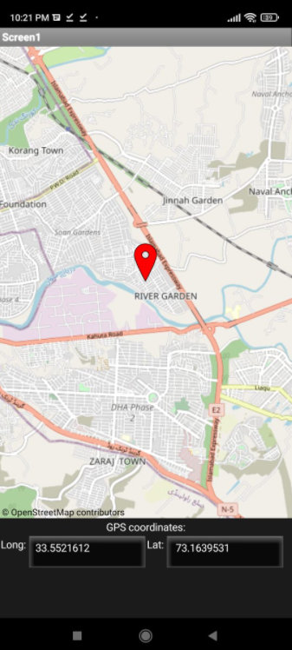
Android Application:
With SMS
Built with MIT app inventor
Only works for android devices
With Bluetooth

Slide 11
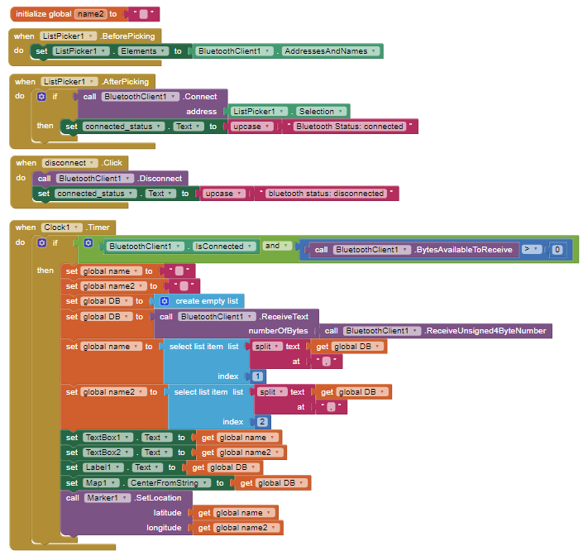
code:

Slide 12
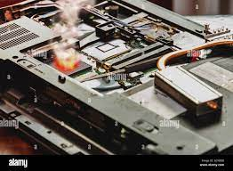
Problem with ATMEGA 32:
Unavailability of MAX32 code burner.
Alternative: Using Arduino Uno as a code burner.
Which unfortunately fried the ATMEGA32 chip.
We were forced to switch to Arduino Uno.

Slide 13

Future:
Using esp-32
Using internet communication will increase the range of transmission by several folds and hence widen the tracking area. Use of boosters which are costly and not feasible for small scale projects.
Upgrade mobile app
The mobile app can be ungraded infinitely by addition of extra features such as route detection, speed display, voice control e.t.c.

